Slide 1
Security Controls

Slide 2
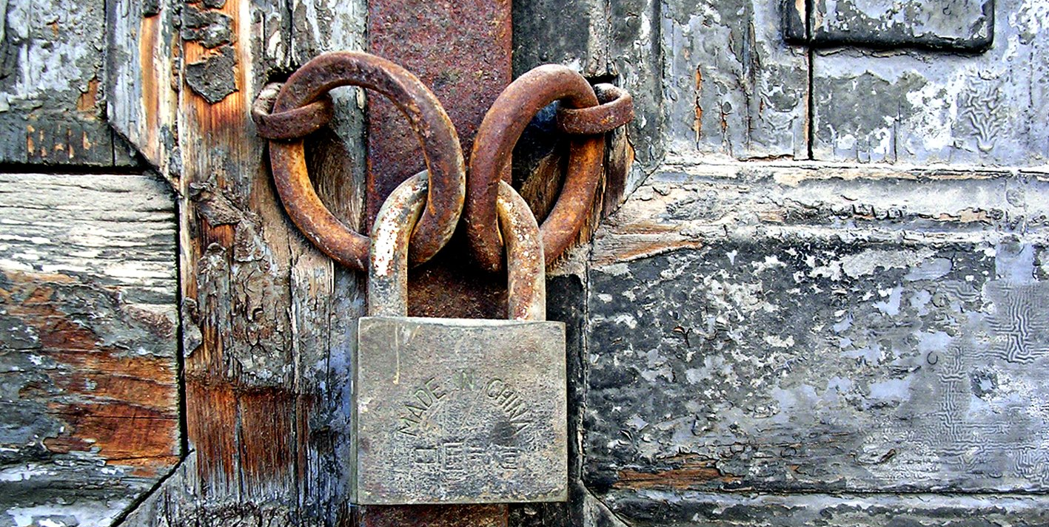
Security controls
Mechanisms employed to minimize exposure to risk and mitigate the effects of loss
Security team should determine the proper set of controls to achieve the security objectives
Many different types of security controls

Slide 3

Control types
Deterrent
Used to discourage an attacker
Examples can be laws and regulations
Preventive
Prevents actions from occurring
Mantrap can prevent tailgating
Detective
Detects a physical security breach
Alerts an operator

Slide 4
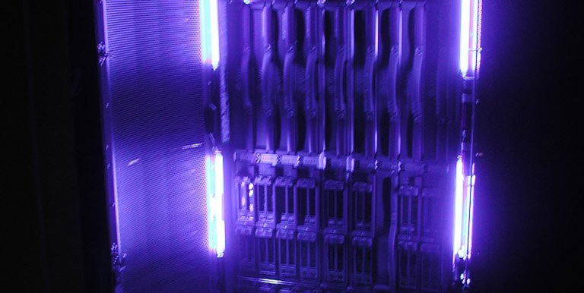
Control Types
Corrective
Used post event to minimize the damage
Backups are an example
Compensating
If not control is available, these are used to address the threat
Fire suppression systems don’t prevent fires, but limit the damage

Slide 5

Control Types
Technical
Technology as a physical security issue
Finger scanners are an example
Administrative
Policy or procedure to limit risk
Physical
Prevents physical actions from occurring
Covers to prevent accidental bumping/touching

